Slide 1
3D Game Development and Design
A seminar Presented by
Bharath SN
Usn no: 4jc09cs014
Roll No : 07
Dept. of Computer Science and Engineering, 8th sem, ‘B’ section, SJCE Mysore
Under the guidance of
Divakara N
Asst. professor, Dept. of Computer Science and Engineering,
Mysore.

Slide 2
Contents
Introduction to 3D computer graphics and Game Engines
Ogre Game Engine
GUI based Game Engines
CryENGINE 3
Introduction to Shader programming
References

Slide 3
Introduction to 3D Computer Graphics and Game Engines
3D computer graphics are graphics that use a three-dimensional representation of geometric data that is stored in the computer for the purposes of performing calculations and rendering 2D images.
3D computer graphics are often referred to as 3D models.
A 3D model is the mathematical representation of any three-dimensional object. A model is not technically a graphic until it is displayed.
Developing games Involve three basic phases
  3D modeling :- The process of forming a computer model of an object's shape
  Layout and Animation :- The motion and placement of objects within a scene
  Rendering :- The computer calculations that, based on light placement, surface types, and other qualities, generate the image

Slide 4

Introduction to 3D Computer Graphics and Game Engines
3D Game Engine (simply Game Engine) :
  A game engine is a system / software product designed for the creation and development of video games.
  The leading game engines provide a software framework that developers use to create games for video game consoles and personal computers.
  The core functionality typically provided by a game engine includes a rendering engine (“renderer”) for 2D or 3D graphics, a physics engine or collision detection (and collision response), sound, scripting, animation, artificial intelligence, networking, streaming, memory management, threading, localization support, and a scene graph.

Slide 5
Introduction to 3D Computer Graphics and Game Engines
Game engines are typically somewhat genre speciﬁc.
List of game genres –
  First-Person Shooters (FPS) :- eg., Call of duty, Crysis, counter strike. etc
  Platformers and Other Third-Person Games :- eg., Space Panic, Donkey Kong, etc
  Fighting Games :- eg., Fight Night Round 3, mortal combat , etc
  Racing Games :- eg., Need for speed ,blur, etc.
  Real-Time Strategy (RTS) :- eg., The Building of a Dynasty, Age of empires, etc.
  Massively Multiplayer Online Games (MMOG) :- eg., warface, Neverwinter Nights, EverQuest, World of Warcraft , and Star Wars Galaxies, etc.

Slide 6
Top 10 Game Engines
RAGE (Rock Star Advanced Game Engine) :- GTA Series
CryENGINE 3 :- Crysis series
Naughty Dog Game Engine :- Uncharted: Drake's Fortune
The Dead Engine :- Dead Space
Unreal Engine :- Mass Effect Series, Call Of Duty Black ops
Avalanche Engine :- The Hunter
IW (Infinity Ward) Engine :- Call of Duty MW1 and 2
Anvil Engine :- Assassin's Creed1 & 2, Prince of Persia
EGO Engine :- Dirt
Geo-Mod Engine :- Red Faction: Guerrilla

Slide 7
Introduction to OGRE
OGRE is an acronym for Object-Oriented Graphics Rendering Engine.
Ogre is a scene-oriented, real-time, flexible 3D rendering engine written in C++ designed to produce applications utilizing hardware-accelerated 3D graphics.
The class library abstracts the details of using the underlying system libraries like Direct3D and OpenGL
OGRE has received multi-platform support
it doesn't provide audio or physics support.
Features of Ogre
  OGRE has an object-oriented design with a plugin architecture
  OGRE is a scene graph based engine,
  It supports variety of scene managers
  Platform & 3D API support
  Material / Shader support
  Meshes , Animation, Special Effects, etc.

Slide 8
Ogre Scene Manager
What is a scene… ?
  A scene is an abstract representation of what is shown in a virtual world.
  It consists of static geometry such as terrain, building interiors, trees, chairs or monsters, light sources
  It also consists of cameras
Ogre supports the following set of scene managers
  Generic/Default SceneManager
  Octree SceneManager
  BSP(Binary Space Partitioning) SceneManager
  PCZ (Portal Connected Zone) SceneManager
What does a SceneManager do … ?
  Monitors and Maintains all the assets present in the current scene.
  It is capable of handling scene nodes, entities, lights, Particles, or a lot of other object types.
  SceneManager object is under the control of the Root object.
  The Root object/node is the father of all the assets present in the scene and ofcourse u can navigate from one node to another by using root object.

Slide 9
Scene Managers
Generic/Default :- It’s the default scene manager Uses Built hierarchy for frustum culling, RayCasting is worst.
BSP : - It is an Old technique but this is intended for use in interior scenes. it is optimized for the sort of geometry that results from intersecting walls and corridors.
Octree :- It will quickly cull entire regions of the world(In the World space).That is if a parent region is not visible to the camera then there is no need to check the children of that node. RayCasting is efficient.
PCZ :-The Portal Connected Zone manager allows you to define zones in the world and portals which connect them. It's harder to set up because this isn't automatic, you need to place zones and portals
  Optimized for interior scenes.
  Compatible with numerous level editing tools.

Slide 10
BSP tree
A Binary Space Partitioning-tree is a structure that, as the name suggests, subdivides the space containing objects/assets into smaller sets by hyperplanes.
Introduced by Fuchs, Kedem, and Naylor around 1980.
It uses the painter’s algorithm for creating and sorting the objects/nodes in the scene.
Painter’s algorithm allows to order the objects stored at the leaves of a BSP tree in back-to-front order from the viewpoint
Enhances the rendering of static scenes.
It uses z-buffers for rendering the objects, then it checks the z-value for each and every polygon so that closest is drawn last.
BSP Algorithm involves 2 steps
  Generating tree
  Traversing the generated tree

Slide 11
BSP Algorithm
The recursive algorithm for construction of a BSP tree from that list of polygons
  Choose a polygon P from the list.
  Make a node N in the BSP tree, and add P to the list of polygons at that node.
  For each other polygon in the list:
    If that polygon is wholly in front of the plane containing P, move that polygon to the list of nodes in front of P.
    If that polygon is wholly behind the plane containing P, move that polygon to the list of nodes behind P.
    If that polygon is intersected by the plane containing P, split it into two polygons and move them to the respective lists of polygons behind and in front of P.
    If that polygon lies in the plane containing P, add it to the list of polygons at node N.
  Apply this algorithm to the list of polygons in front of P.
  Apply this algorithm to the list of polygons behind P.

Slide 12


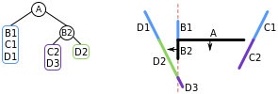

BSP Algorithm
Let us assume A,B,C and D are polygons and we are
viewing the space from the top.Rounded rectangle is the
List.
choose a line, A, from the list and add it to a node.
split the remaining lines in the list into those in front of A
and those behind
Repeat the process for each and every sub polygons as follows.

Slide 13
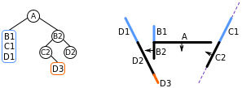




BSP Algorithm
From the last slide…

Slide 14

BSP Algorithm
Traversing the tree…
If the current node is a leaf node, render the polygons at the current node.
Otherwise, if the viewing location V is in front of the current node:
  Render the child BSP tree containing polygons behind the current node
  Render the polygons at the current node
  Render the child BSP tree containing polygons in front of the current node
Otherwise, if the viewing location V is behind the current node:
  Render the child BSP tree containing polygons in front of the current node
  Render the polygons at the current node
  Render the child BSP tree containing polygons behind the current node
Otherwise, the viewing location V must be exactly on the plane associated with the current node. Then:
  Render the child BSP tree containing polygons in front of the current node
  Render the child BSP tree containing polygons behind the current node

Slide 15
BSP Drawbacks
Polygons will not be drawn correctly if they pass through any other polygon.
It is difficult and computationally expensive to calculate the order that the polygons should be drawn in for each frame.
The algorithm cannot handle cases of cyclic overlap as shown in the figure below.
It does not solve the problem of visible surface determination.
It consumes more memory space.

Slide 16
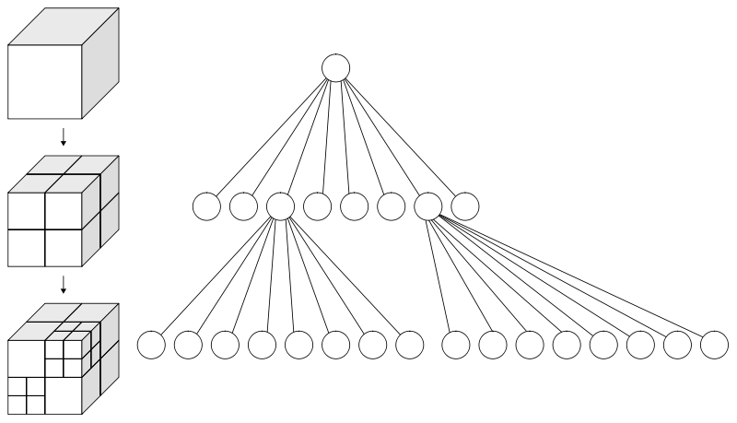
Octree
It is more efficient than the BSP scenemanager
Octree solves all the problems and drawbacks of BSP
Just like other trees it has a root, each node has a parent, has a maximum of 8 childern.

Slide 17
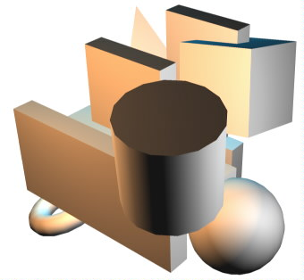
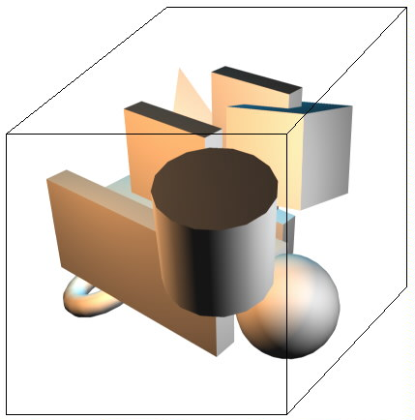
Octree
Each node in an octree subdivides the space it represents into eight octants
Each node also has a chosen middle point inside this box
For example :- consider a scene bunch of polygons ramdomly distributed in the space. The construction goes like…

Slide 18
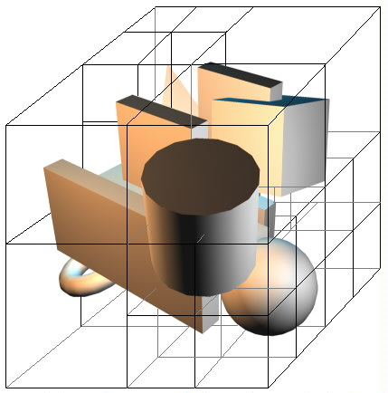
Octree algorithm
The Octree algorithm generates the final tree containing the objects in the divided space.
- We can the larger cubes as parents
and smaller cubes as children.
- There are two ways to stop the subdividing process.
- The first one is to stop when a cube has some size smaller then a fixed number
- The second one is to stop
subdividing when the number of polygons in a cube is smaller then some fixed number.

Slide 19
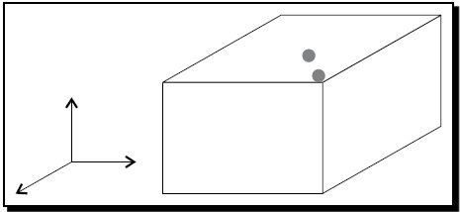
Octree creation
Now consider a 3D scene with two objects in it.
Enclose those two objects in a cube.
Divide the cube at half of its width, height and depth. The resultant 8 cubes can be thought of 8 children of the original cube.

Slide 20
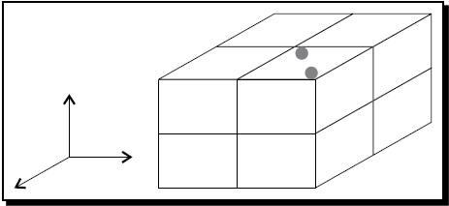
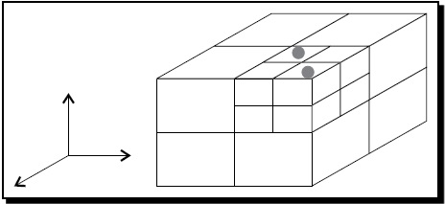
Octree creation
Now the two objects of the scene are in the right upper-front cube. The seven other cubes are empty and are therefore leaves. We will divide the cube that contains the two objects again.

Slide 21
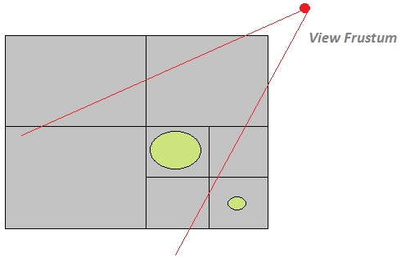
Octree creation
Each cube has either one or no object enclosed and is a leaf.
This property of an Octree makes culling easy and fast.
To determine which objects have to be rendered, we just have to check If the view frustum intersects with each and every child the cube or not.
If intersects then draw the cube else cull the cube.

Slide 22
Game Engines having GUI
The traditional Ogre engine doesn’t have GUI.
Developing games from OGRE platform need to start from the scratch.
Would be time consuming.
Have to hard code our own customized shaders for texturing.
Have to plot the co-ordinate in the in the 3D space to placing the objects
One solution for all the problems is to use the game engines having GUI.
Drag and drop Environment.
Ogre has a GUI enabled engine called “neo-axis”.

Slide 23
CryENGINE 3
The CryENGINE 3 is a game engine which drives the visual actions taking place on the screen.
It is a wholly “What you See Is What U Play(WYSIWIP)” technology.
Game Engine designed by Crytek.
The most prominent tool provided by a game engine is the level. This is done by CryENGINE 3 sandbox.
It contains Each and every tools needed for level designing like, assets, models, animations, texturing, Video rendering, Audio subsystem, AI subsystem, material editor, etc…
It is specifically designed for first-person shooter genre.
Freely available at www.crydev.net .

Slide 24

CryENGINE 3
(our college lobby)

Slide 25
Introduction to Shader Programming
A shader is a computer program that runs on the graphics processing unit and is used to do shading.
The main program as being executed just once on a CPU. But a shader program is executed repeatedly on a GPU.
Executed for each and every elements of data in a stream.
Shaders calculate rendering effects on graphics hardware with a high degree of flexibility
The material editor auto-generates the shader code during texturing.
There are three types of shading languages available
  HLSL(High level shading language) / Direct 3D
  GLSL ( Open GL shading language)
  CG (by NVIDIA and Microsoft )
Types of Shaders
  Vertex Shaders
  Geometry shaders
  Fragments/pixel shaders.

Slide 26
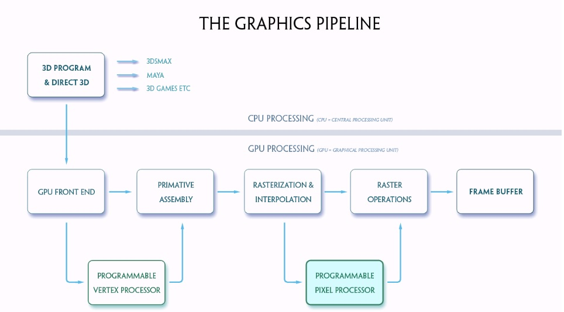
Shaders( GPU pipeline)

Slide 27
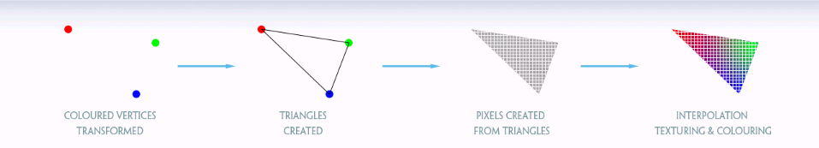
Shaders ( Data flow)

Slide 28
Simple shader program(HLSL)
UI elements
float4 AmbientColor : Ambient
<
string UIName = "Ambient Color";
= {0.25f, 0.25f, 0.25f, 1.0f};
float4 DiffuseColor : Diffuse
<
string UIName = "Diffuse Color";
> = {1.0f, 1.0f, 1.0f, 1.0f};
float4 SpecularColor : Specular
<
string UIName = "Specular Color";
> = { 0.2f, 0.2f, 0.2f, 1.0f };
float Glossiness <
string UIWidget = "slider";
int UIMin = 1;
int UIMax = 128;
int UIStep = 1;
int UIStepPower = 16;
string UIName = "Glossiness";
= 40;
texture diffuseMap : DiffuseMap
<
string name = "default_color.dds";
string UIName = "Diffuse Texture";
string TextureType = "2D";
>;
texture normalMap : NormalMap
<
string name = "default_bump_normal.dds";
string UIName = "Normal Map";
string TextureType = "2D";
>;

Slide 29
Simple shader program(HLSL)
Input from application
struct a2v
{
float4 position : POSITION;
float2 texCoord : TEXCOORD0;
float3 tangent : TANGENT;
float3 binormal : BINORMAL;
float3 normal : NORMAL;
};
Output to fragment program
struct v2f
{
float4 position : POSITION;
float2 texCoord : TEXCOORD0;
float3 eyeVec : TEXCOORD1;
float3 lightVec : TEXCOORD2;
float3 worldNormal : TEXCOORD3;
float3 worldTangent : TEXCOORD4;
float3 worldBinormal : TEXCOORD5;
};

Slide 30
Simple shader program(HLSL)
Vertex shader part …
v2f vertex(a2v In, uniform float4 lightPosition )
{
v2f Out;
- - - - - - - - - - - - - - - -
- - - - - - - - - - - - - - - -
//vertex shader program goes //here
- - - - - - - - - - - - - - - -
- - - - - - - - - - - - - - - -
return Out;
}
Fragment / pixel shader part …
float4 fragment(v2f In,uniform float4 lightColor) : COLOR
{
float4 color_val ;
- - - - - - - - - - - - - - - - - - - -
- - - - - - - - - - - - - - - - - - - -
//pixel shader program goes //here
- - - - - - - - - - - - - - - - - - - -
- - - - - - - - - - - - - - - - - - - -
return color_val;
}

Slide 31
Simple shader program(HLSL)
Techniques and passes…
Techniques are the variations in the shaders
Passes are one complete trip down the graphics pipeline
technique regular
{
pass one
{
VertexShader = compile vs_1_1 v(light1Pos);
ZEnable = true;
ZWriteEnable = true; CullMode = CW; AlphaBlendEnable = false; PixelShader = compile ps_2_0 f(light1Color);
}
}

Slide 32

Q & A

Slide 33
References
www.ogre3d.org
www.crydev.net
Nvidia official web page
Nvidia cg tool kit users manual
Wikipedia.
Thank U …………………….

